Slide 1
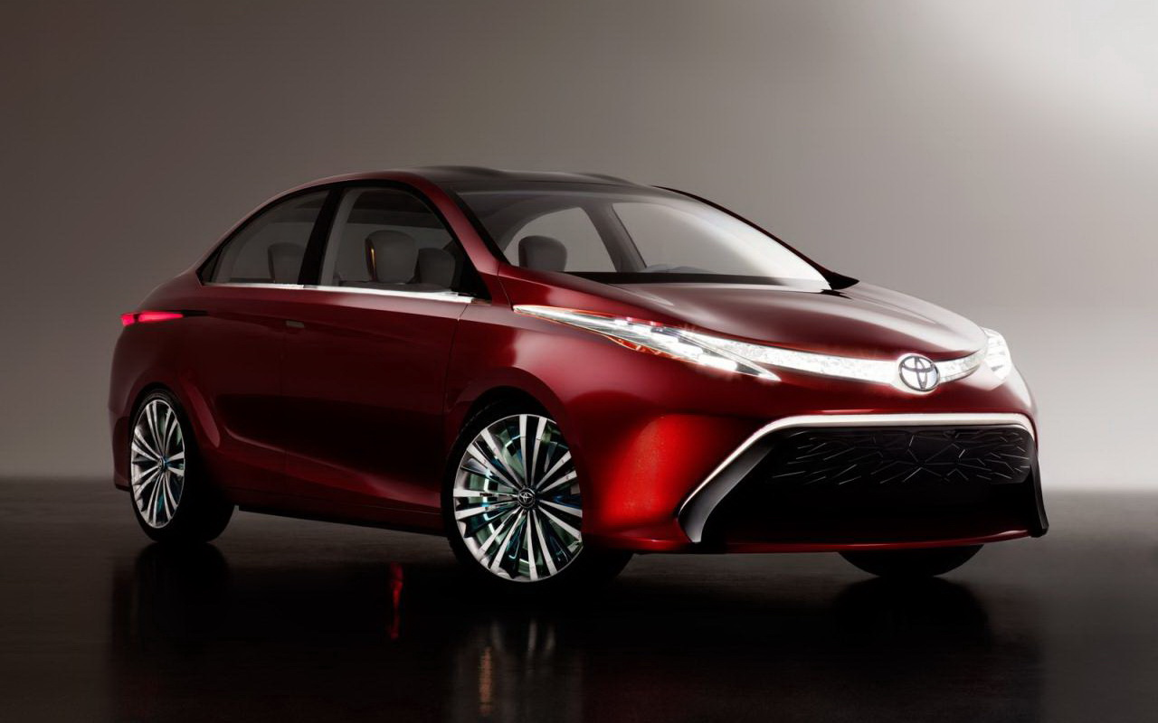
Toyota Challenge
Hridya Dhulipala
Priya Singh

Slide 2
problem
STATEMENT
Toyota’s vision is for customers to experience amazing. Using the latest tech trends, you are tasked with creating a next-gen mobility solution that enhances safety and/or convenience, further elevating the unsurpassed Toyota customer experience. Use your imagination to develop the concept, build documentation & visualization and vividly demonstrate it through a software MVP that helps our judges understand and appreciate your core idea. We can’t wait to see your vision come to life!

Slide 3


SOLUTIONS
CAUTION ALERT
TRAFFIC NOTIFICATION

Slide 4
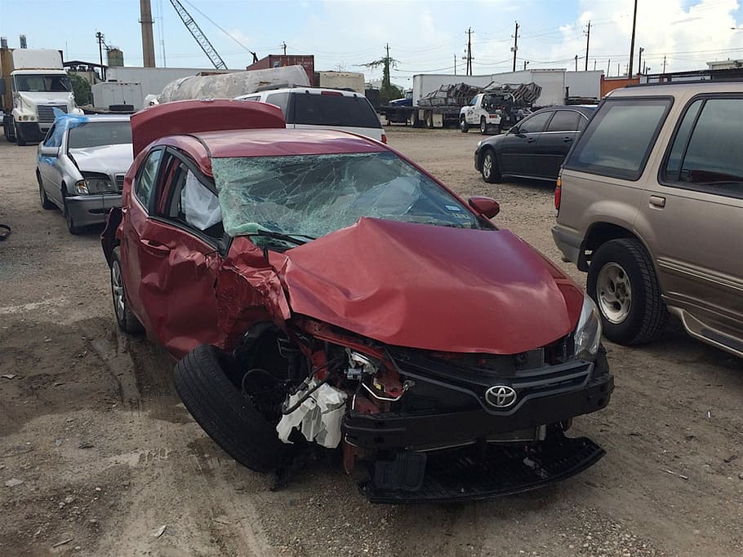
Caution alert!
TOYOTA CHALLENGE
4

Slide 5
Accident Prone areas in dallas
Central Expressway from LBJ Freeway to I-30
I-35W from Loop 820 to I-30 (TArrent County)
LBJ Freeway from I-35E to Dallas North Tollway
East Loop 820 from I-30 to I-20
Average daily VMT: 2,227,731 Total crashes: 1,230 Crash rate: 151.27
Average daily VMT: 1,002,630 Total crashes: 530 Crash rate: 143.19
Average daily VMT: 527,497 Total crashes: 295 Crash rate: 153.22
Average daily VMT: 706,900 Total crashes: 491 Crash rate: 190.30

Slide 6
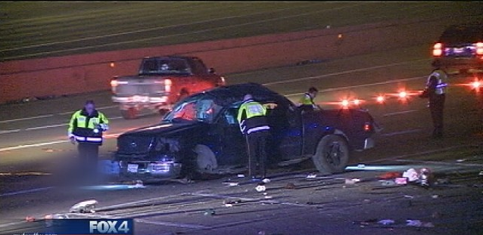

Caution alert!
The software detects the location of the vehicle and alerts the driving when he is approaching an accident-prone zone.

Slide 7
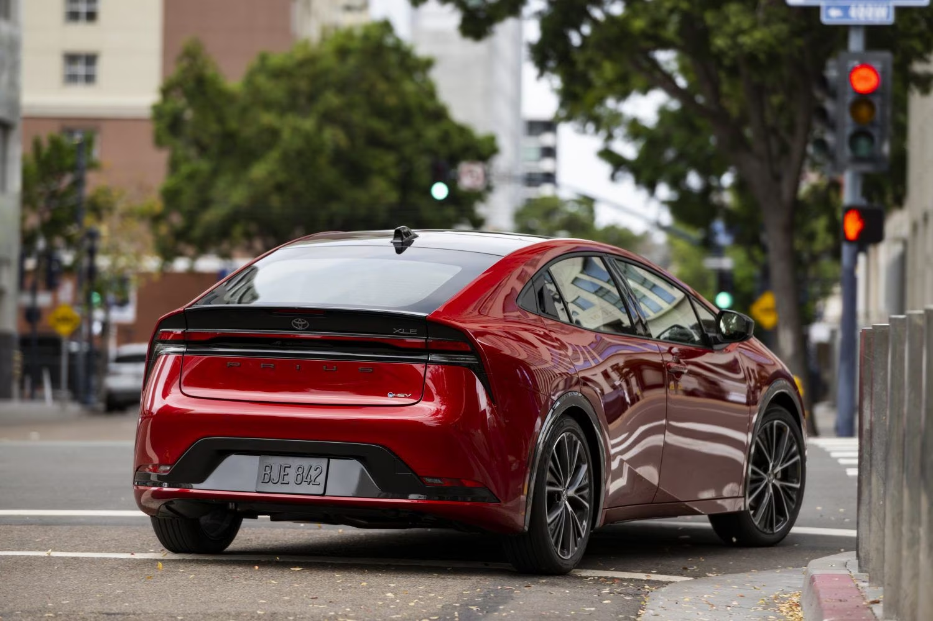
Traffic notification
TOYOTA CHALLENGE
7

Slide 8
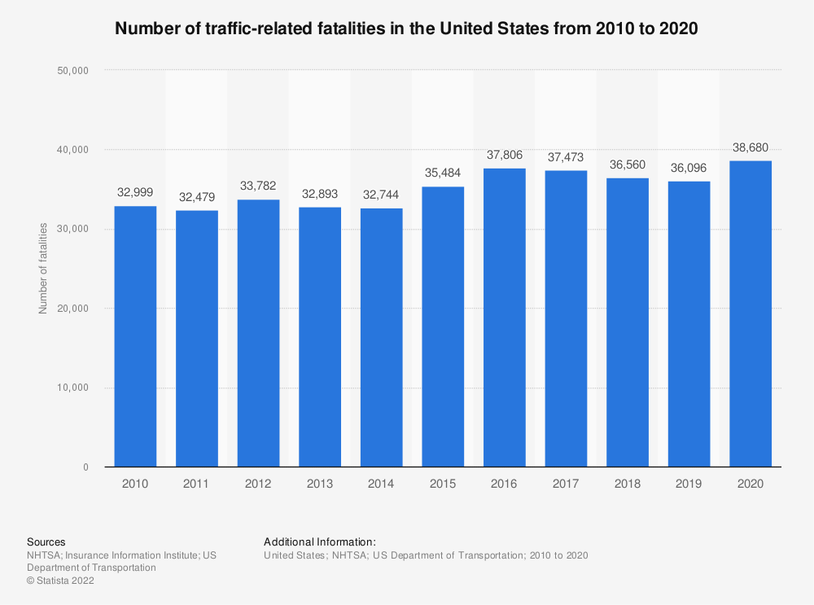
Present stats

Slide 9

Preventive measure – our solution
Using the real time traffic signal network and the car’s GPS, the software notifies the driver of the nature of traffic flow, ahead of the intersection, that the driver is approaching.

Slide 10
Thank you
Questions​

